Slide 1
Wrap-up module 1 Intro to module 2 & 3
20 Nov 2023

Slide 2
Quiz
You’re reading the methods chapter of a paper that applies questionnaire research. In the methods chapter, the questionnaire items are not included. Therefore, the following hallmark of scientific research is harmed:
Testability
Replicability
Precision
Parsimony
Notes:
Replicable means that other reserachers can repeat the same steps and find similar results. If the questionnaire is not included, this is not possible.

Slide 3
Quiz
2. A researcher makes the following hypothesis:
There are businesses that do not use any data analytics to inform their decisions
This hypothesis is
Testable and falsifiable
Not testable, yet falsifiable
Not falsifiable, but testable
Not testable, and not falsifiable
Notes:
Falsifiable means that evidence can be collected to state the hypothesis is not correct. When do we conclude that this statement is not true? Even if we have studied 100 businesses, and they all use business analytics to inform their decisions, we still don’t know if it is correct to reject the statement. Because there could still be another business that doesn’t use data analytics.
In general, `there is’ statements are not falsifiable.
You could make the statement falsifiable by adding for instance, `most’ or `the majority’

Slide 4
Quiz
3. Most quantitative studies assume a positivist perspective: there is an objective truth that can be measured objectively. Which perspective diverges the most from the positivist perspective?
Constructionism
Critical realism
Pragmatism
Notes:
See the book, chapter 1!

Slide 5
Quiz
4. A researcher observes how business managers utilize data analytics for inform their decision-making. From the observation, she derives three common patterns. This research would be called
Inductive
Deductive
Notes:
Inductive (from specific observations to generic inferences)

Slide 6
Quiz
5. A researcher wants to know how business managers in general utilize data analytics for inform their decision-making. She visits a business analytics conference to invite managers for an interview. This approach harms
External validity
Internal validity
Notes:
External validity (by selecting people that are anyway interesting in analytics, the sample is not going to be representative for the population)

Slide 7
Quiz
6. Consider the topic you chose for the last weekly assignment. Write down a testable and falsifiable hypothesis that would answer your research question
Notes:
Make sure you write a hypothesis that can be tested (so avoid subjective/normative words) and that can be falsified (so it should be possible to collect data that rejects the hypothesis)

Slide 8
Quiz
6. Consider the topic you chose for the last weekly assignment. Write down a testable and falsifiable hypothesis that would answer your research question
Notes:
Make sure you write a hypothesis that can be tested (so avoid subjective/normative words) and that can be falsified (so it should be possible to collect data that rejects the hypothesis)

Slide 9


Know your guest lecture: Antragama Abbas
Profile
PhD researcher at the TPM
Topic: data sovereignty in data sharing via meta-platforms.
He was a technology consultant at Accenture
Course Involvement
MOT2312 Research methods
SEN1621 I&C services design
SEN1641 Digital platform design
SEN131A Research challenges
My Ambition
For me: To get critical feedback for “my” research method!
For you: Critically evaluate the outcomes of an MOT project (LO 2)
A.E.Abbas@tudelft.nl
Faculty of Technology, Policy and Management
Building 31
Room: B3.310

Slide 10

Topic: data sovereignty in data sharing via meta-platforms
An illustrative case: The City’s Smart Cafes
Imagine a city where all the cafes are equipped with IoT (Internet of Things) devices. Each cafe has its own IoT platform, which they use to get insight on:
The number of people entering and exiting.
The temperature and humidity levels inside.
The number of coffees sold each hour.
The popular times of the day.

Slide 11
Topic: data sovereignty in data sharing via meta-platforms
Meta-platform
…a platform designed to operate atop of two or more existing platforms, thereby connecting their respective ecosystems by serving as an orchestrator.
City-Wide Insights
Collaborative Promotions
Share data insights
Café A
Café N
IoT platform A
IoT platform.. N
data sovereignty concerns is the inability of data providers to control the shared data
E.g., loss of competitive advantage

Slide 12
Assignment
Existing studies generally define data sovereignty as the ability of data providers to control the shared data. Yet, data sovereignty relates to other concepts, such as data ownership and security. A control-centric understanding of data sovereignty leads scholars and practitioners to create partial solutions. For example, existing technical solutions focus on access control, leaving other sovereignty aspects unaddressed.
Describe the research problem in your own words
Formulate a descriptive research question
Formulate an explanatory research question
(Abbas et al., under review)

Slide 13
Assignment
Meta-platforms amplify data sovereignty concerns: the inability of data providers to control the shared data. Control mechanisms (i.e., certification, smart contract) help maintain data sovereignty. Nevertheless, the complex offerings of meta-platforms (e.g., enabling data flow from an IoT platform to others) make us question the efficacy of these control mechanisms. This study aims to evaluate the perceived efficacy of control mechanisms to maintain data sovereignty in meta-platforms. The findings from a survey study (n=93) indicate that respondents perceive high data sovereignty. Smart contracts enable providers to control the shared data; certification signals meta-platforms’ responsibility to deliver secure data-sharing infrastructure.
Describe the research problem in your own words
Formulate a descriptive research question
Formulate an explanatory research question
(Abbas et al., 2023)

Slide 14
Feedback assignment

Slide 15
General remarks
Much to improve, look into the evaluation criteria and write the assignment based on this.
Make sure that the assignment is a comprehensive story and does not consists of parts.
Explain many problem areas in the “Explain your choice using one or more of the criteria” part rather than define a problem area and explain it in the following part.
Social media platforms are not data platforms; core business is not exchanging data.

Slide 16
Problem area: general remarks
Use facts and references; this really strengthens the description of the problem area.
Provide a short explanation of some terms (eg. economic outcomes) , otherwise it hinders the understanding of the problem area/research objectives/research questions.

Slide 17
Problem area with too limited scope Helping only one company to improve
“Recently, social media users, especially Instagram, tend to voluntarily accept the Privacy Policy provided by the platform to enable them to access all of the application’s features”

Slide 18
Problem area: Technical solution instead of problem area
Blockchain:
“Blockchain technologies are widely being used to enhance the privacy of digital systems, and this increases the level of trust of the stakeholders involved. So, to improve the status quo of data platforms being closed, the usage of blockchain technologies is being looked into”
De-anonymization:
“De-anonymization of some aspects of the product can help achieve these goals”

Slide 19
Research objective/question

Slide 20
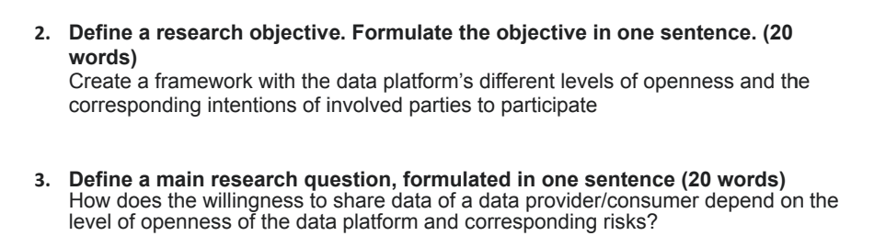
Strong example

Slide 21
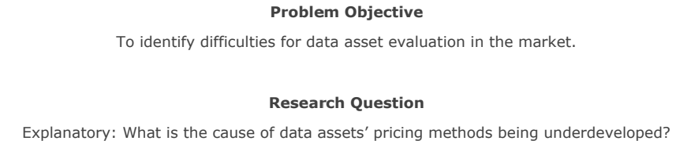
Strong example

Slide 22
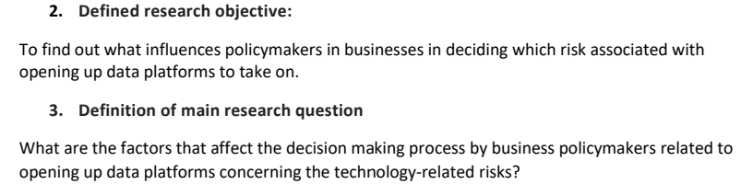
Strong example

Slide 23
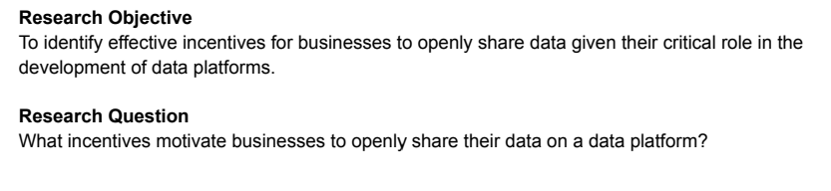
Strong example

Slide 24
Research question/research objective
Make it specific
Consistency
Ensure that the research question helps to realize the research objective

Slide 25
Research objective
Many research objectives without deliverable
Example:
“To investigate the use of blockchain technologies in establishing trust and privacy torealise the openness of data platforms.”
“Figure out what could incentivise companies to share their data so that going about business can be improved”
“using research methods to analyze the business model(s) of data platforms, in terms of finances, for their sustainable (open) future”

Slide 26
Research objective
Without a research component
“Implementation of transparency and traceability within open data platforms to accomplish the demands of the societal values of the users.”
“The goal is to safeguard customer data by managing it responsibly and generating more revenue for the organization”

Slide 27
Research question: good examples
What practices do companies use to assess the validity of data provided by ODP?
How does including a governmental organisation as a data provider for a data platform influence the openness and controllability of data?
To what degree are data platforms, data owners and data consumers willing to participate in platform-to-platform openness and what are their reasons not to?
What factors positively influence CEOs and managers to share their data?

Slide 28
Research question
Avoid normative/policy-related research questions:
Examples:
What causes independent data platforms to succeed or fail in the face of competition from tech giants?
How the design reflexivity of data openness can be useful at various platforms and effectively resolve the privacy breach by use of research knowledge development of big data platforms?
What are the key factors that improve the data sharing process on open data platforms as opposed to the conventional one?
How can we incentivize companies to share their data through a safe open data sharing platform to enable new business opportunities?

Slide 29
Summary
Problem area
No: Solve one company’s problem / make one company more profitable // Yes: General knowledge question
No: Jump to the solution without researching the problem // Yes: Discuss the problem from different perspectives
Research objective
Clear deliverable
Linking relevance to knowledge question
Research question
Focused, one single question
Knowledge question (not policy/strategy, not yes/no)
Empirical

Slide 30
Q&A

Slide 31
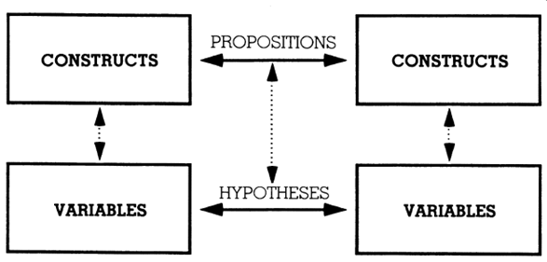
Introduction to module 2 & 3
Conceptual model
Hypotheses
Research design

Slide 32
Why theory?
Notes:
What makes us human
End of theory: big data

Slide 33
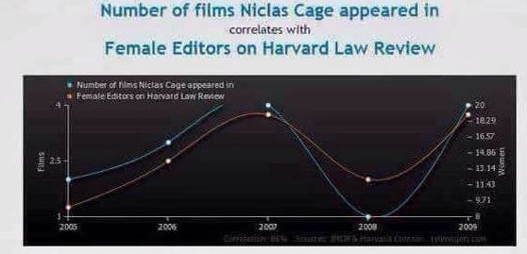
Why theory? Doesn’t data speak for itself?

Slide 34
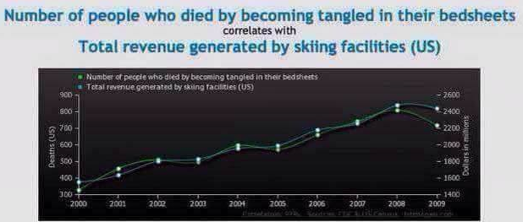
Why theory? Doesn’t data speak for itself?

Slide 35
What theories did you learn in MOT?

Slide 36
Conceptual model / Hypotheses
Independent variable
Dependent variable
Main effect
IMAGINATION
INNOVATION
Moderation
IMAGINATION
INNOVATION
CREATIVE
SKILL
Mediation
IMAGINATION
INVENTION
INNOVATION

Slide 37
How to select a research strategy? Some argumentation given by MSc students
`The company wants me to do a survey among Dutch CIOs, so I’ll do a questionnaire’
`I want to deal with people, not numbers, so I’ll go for workshops’
`I only want to use methods I am comfortable with, so I’ll use regression analysis’
`The company offered me a unique dataset with all their payment transactions of the past year, so I’ll use data mining’
Notes:
Is this acceptable? Is it likely you’ll have similar arguments?
Opportunity is not a sufficient reason!!

Slide 38
Conditions for causality
The independent variable (IV) and dependent variable (DV) should co-vary
The IV should precede the DV
No other (confounding) factor should cause a change in the DV
The relation between IV and DV should derive from a logical explanation (theory)

Slide 39
Tomorrow’s lecture
Practice with the materials of module 2 and 3
Work on case (not the bonus assignment), similar to one you may get in the exam
Preparation needed!
Watch the learning videos from module 2 & 3
Read chapters 5, 6, 11 from S&B

